Slide 1



UNIT 3
LESSON 10
Did you know?
Part 1

Slide 2
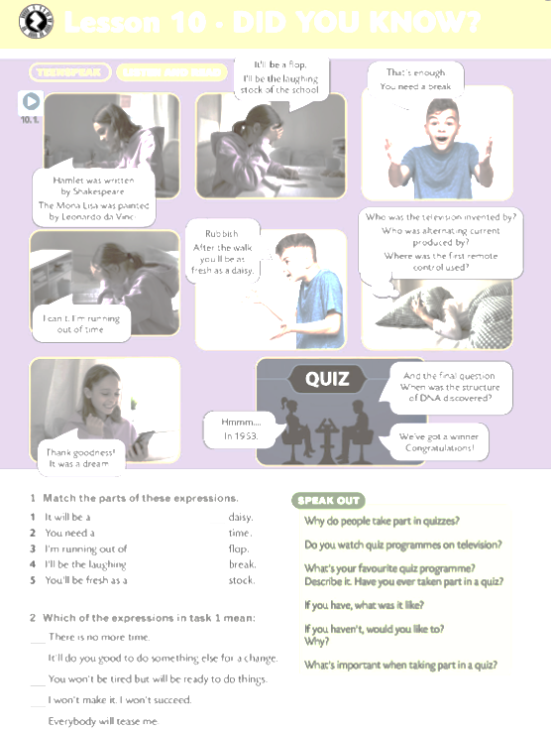
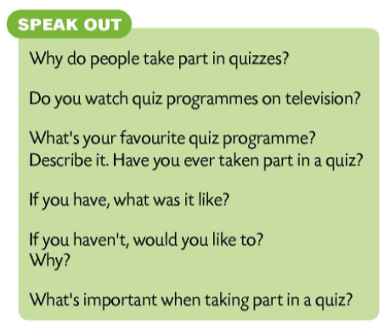

QUIZ
What’s Keiran’s problem? What’s she afraid of? How does she do in the quiz? What is the winning question/answer?
She thinks she will fail and everybody will laugh at her.
She wins the game.
When was the structure of DNA discovered? In 1953.

Slide 3
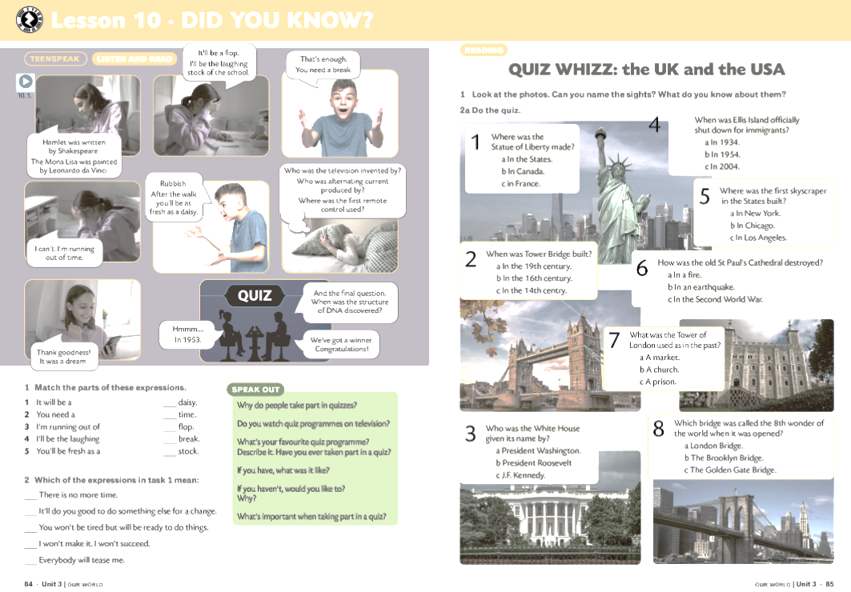
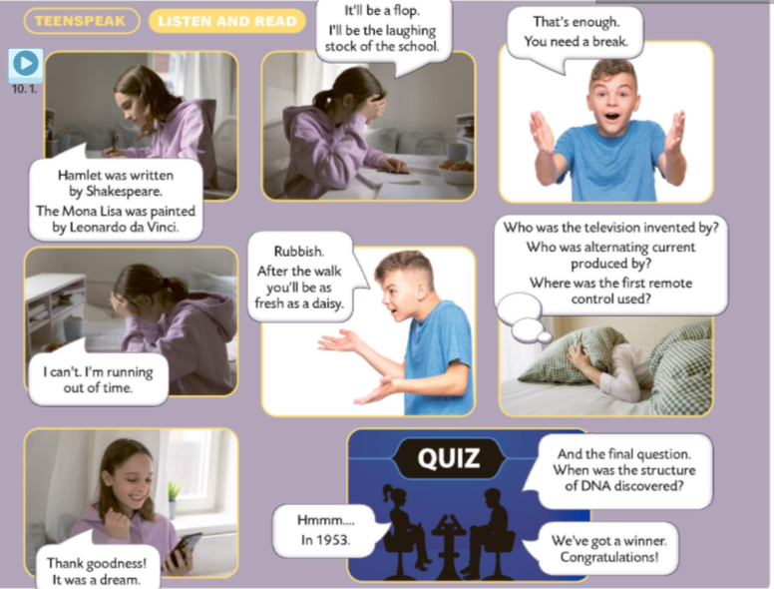
It will be a flop.
I’ll be a laughing stock.
I’m running out of time.

Slide 4
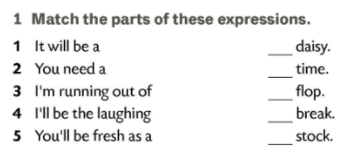
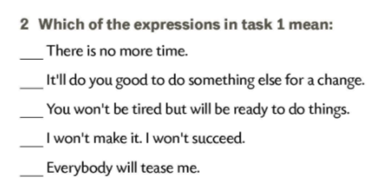
5
3
3
1
2
2
5
4
1
4
The Indiana Jones films were directed by …
J.F. Kennedy was assassinated in…
The Berlin Wall was pulled down in…
The first Olympic Games were held in…
The European Union was established in…
The first computer was created by…
The Mona Lisa was painted by…
The first iPod was invented by…
The first animal that was cloned was…
The atomic bomb was first used in…
Hamlet was written by…
The television was invented by…

Slide 5
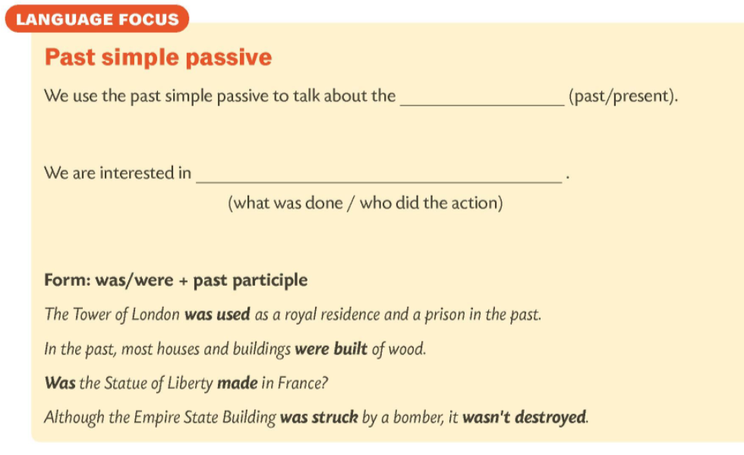
past
what was done

Slide 6
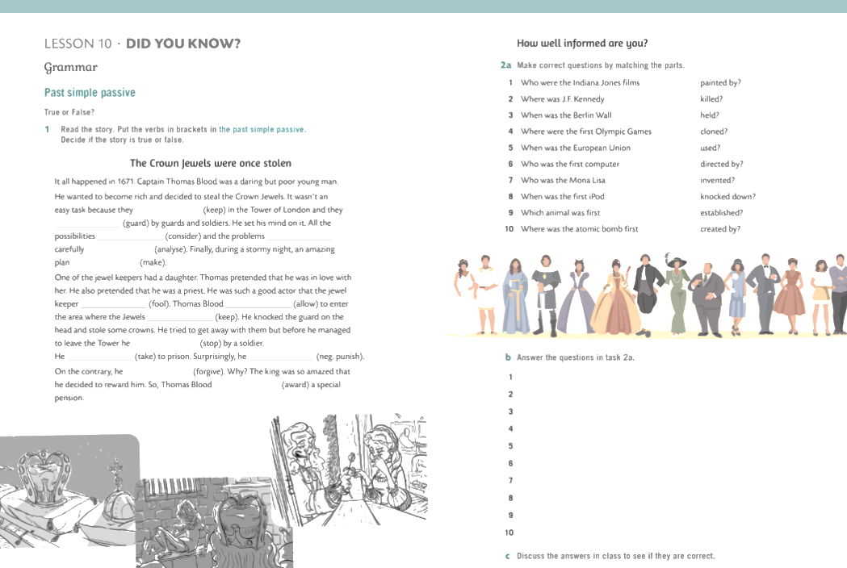

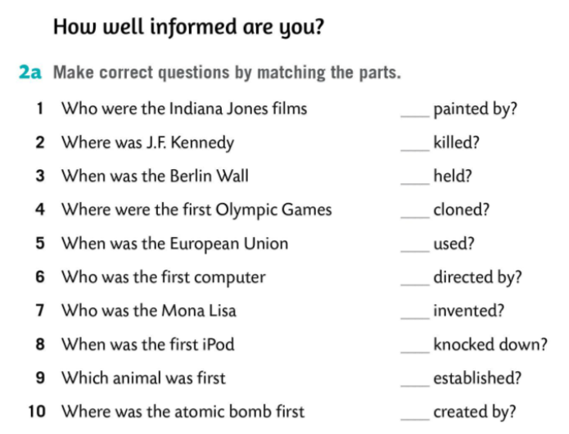
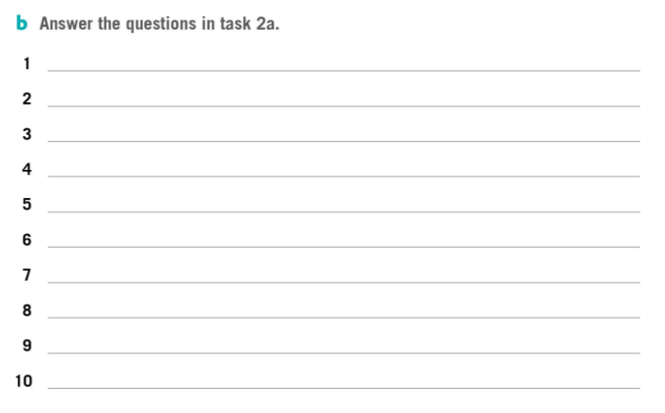
7
2
4
9
10
1
8
3
5
6

Slide 7


